Slide 1
Climate Knowledge Hunt
Post Hackathon Pitch to SDG Accelerator
Produce and test interactive hybrid workshop to make climate reports accessible
Shweata N. Hegde
Undergrad (Science and Education)
Co-founder of science podcast, IndiaAsksWhy
Intern, Manager, Volunteer at openVirus, CEVOpen, Semantic Climate

Slide 2
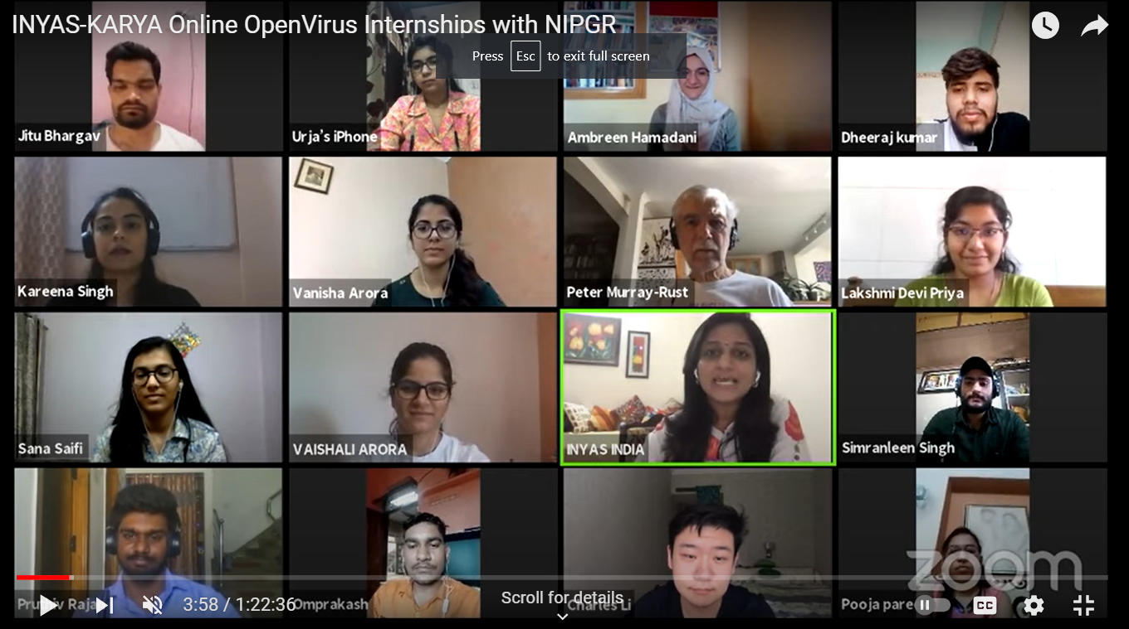
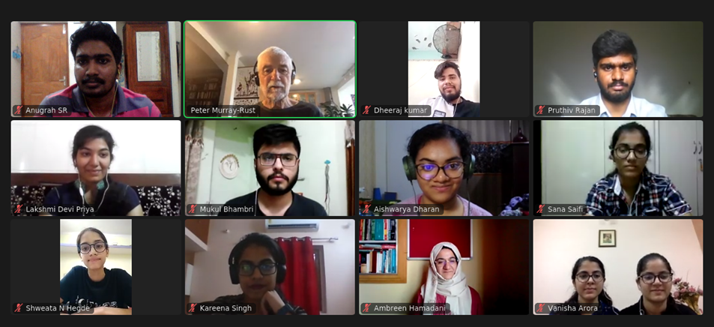
About the team
Remote internships for 2 and half years
Advisors
Volunteers
Dr Gitanjali Yadav, NIPGR
Dr Peter Murray-Rust, University of Cambridge
Dr Ambreen Hamadani
Ayush Garg
Shweata N. Hegde
Emanuel Faria

Slide 3
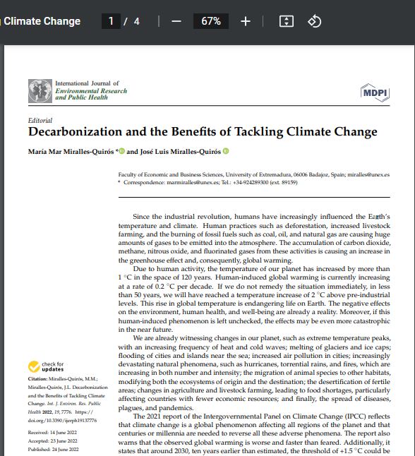


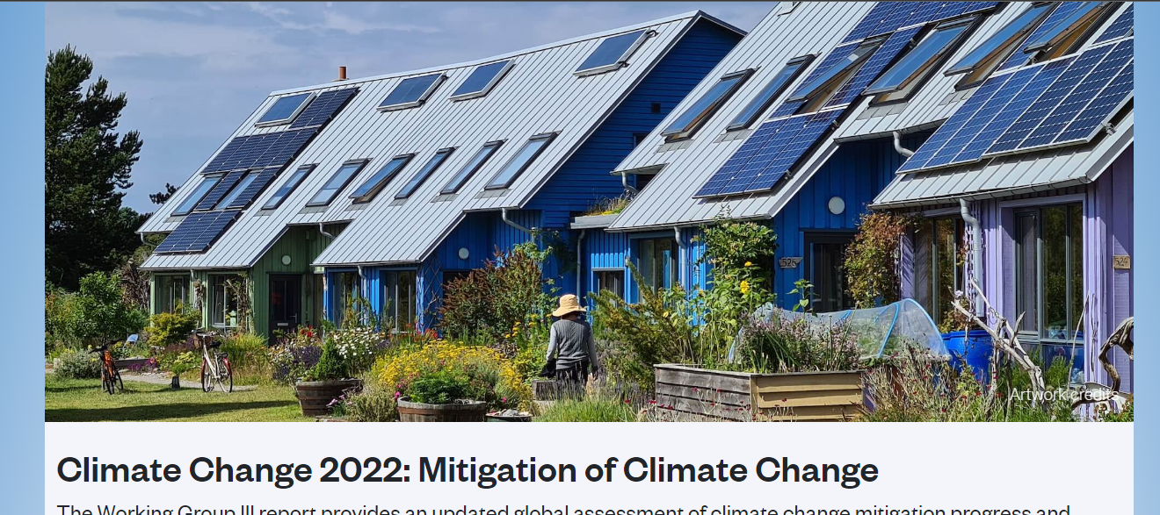
Information to save the world is locked in PDFs.
Screenshot
IPCC, IPBES, annual reports
30000 + pages
Miralles-Quirós MM, Miralles-Quirós JL. Decarbonization and the Benefits of Tackling Climate Change. International Journal of Environmental Research and Public Health. 2022 Jun;19(13):7776. DOI: 10.3390/ijerph19137776. PMID: 35805430; PMCID: PMC9266008.
Notes:
Swap the two
Expand IPCC, etc
Add screenshot of IPCC reports

Slide 4

Glimpse of tools
…despite mitigation efforts 8 including those in near-universal nationally determined contributions (NDCs)…
pyami
< >
HTML
docanalysis
IPCC chapters,
IPBES reports,
…
Millions of scientific papers

Slide 5

Climate-related terms dictionary
…despite mitigation efforts 8 including those in near-universal nationally determined contributions (NDCs)…
pyami
< >
HTML
docanalysis
IPCC chapters,
IPBES reports,
…
Abbreviation dictionary
Millions of scientific papers

Slide 6
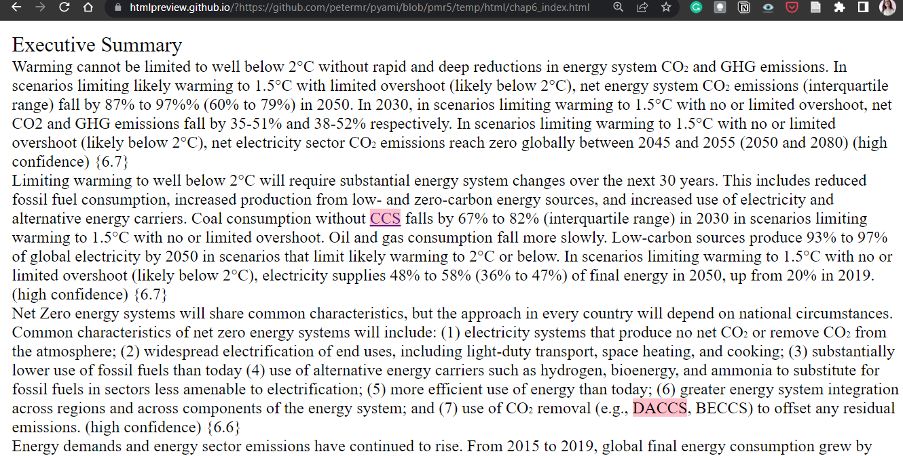

Slide 7
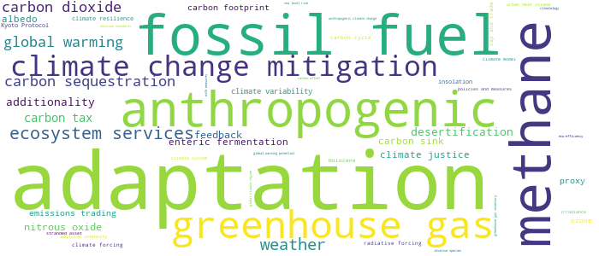
Demo link
{'adaptation': 286, 'fossil fuel': 111, 'methane': 107, 'anthropogenic': 83, 'greenhouse gas': 81, 'climate change mitigation': 66, 'ecosystem services': 48, 'weather': 44, 'carbon sequestration': 35, 'global warming ': 33, 'carbon dioxide': 33, 'carbon tax': 21, 'desertification’: …}
docanalysis
From 6 chapters of IPCC

Slide 8
(Q260607)
Dictionaries have identifiers!
In different languages…
adaptació al canvi climàtic | No description defined
Central Kurdish | ڕاھاتن بە گۆڕانی ئاووھەوا
Czech | adaptace na globální oteplování
Danish | klimatilpasning

Slide 9
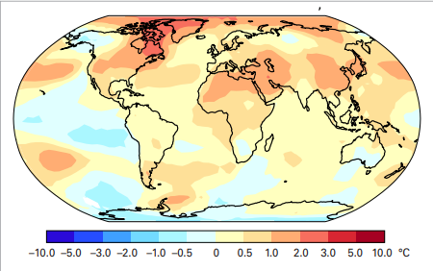
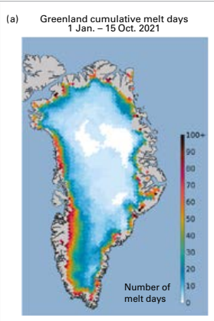
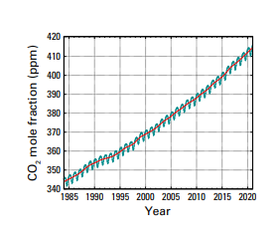
Index 1000 + images reports
https://library.wmo.int/doc_num.php?explnum_id=11178

Slide 10
Climate-related terms dictionary
…despite mitigation efforts 8 including those in near-universal nationally determined contributions (NDCs)…
pyami
< >
HTML
docanalysis
IPCC chapters,
IPBES reports,
…
Abbreviation dictionary
Millions of scientific papers

Slide 11




Tools need people…
pyami
docanalysis

Slide 12
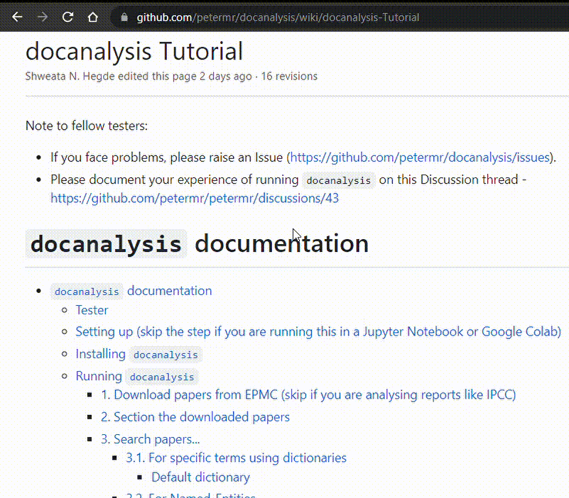
Carpentry model
https://datacarpentry.org/python-ecology-lesson/
Open re-usable learning module for small group workshops

Slide 13

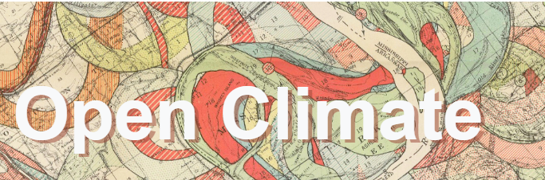


Strengthen Existing Collaborations
Collaborates will..
Document
Adapt/ expand pipeline for specific use cases
Test the learning module
Open Science TIB

Slide 14


Explore potential Collaborations
Collaborates will..
Document
Adapt/ expand pipeline for specific use cases
Test the learning module
Anyone else….
Attend open community events
Wikimedia, open data day, Mozfest, Hacktoberfest

Slide 15
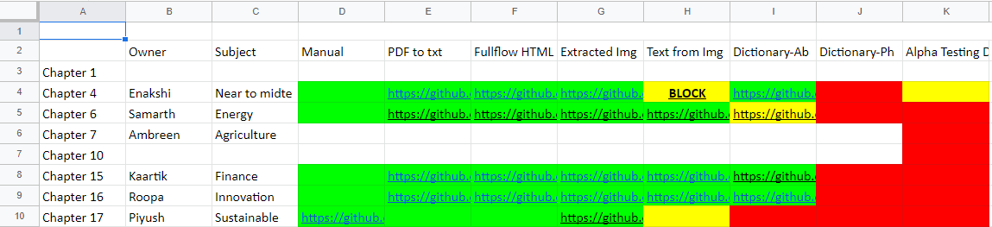


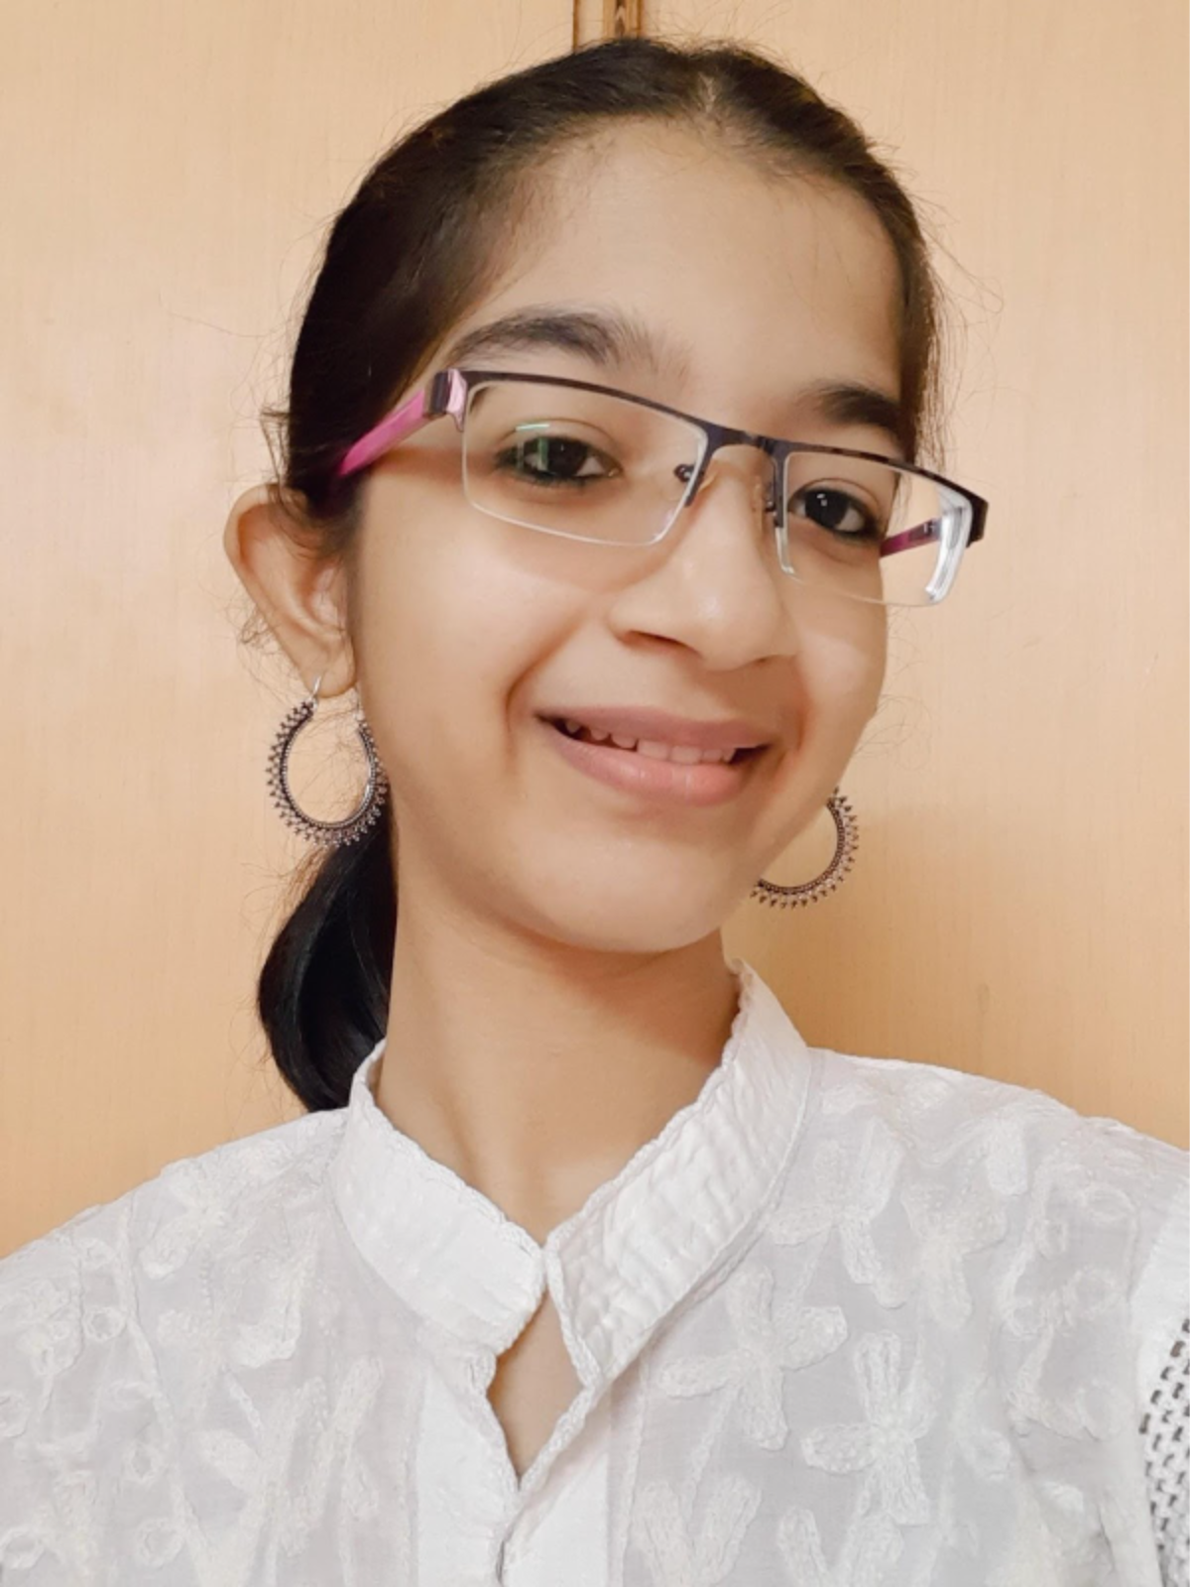
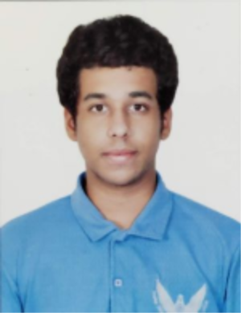
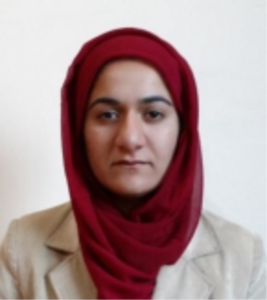
Learning Module Prototype
Each team member owns a chapter…

Slide 16
Climate Knowledge Hunt Workshop
40 delegates
Chapter Champions
Manually summarize: text, video, audio, or image (multilingual)
The report says climate change is…
Curate on
Learning module
Ex: IPCC Reports’ Chapter
docanalysis
pyami
Patterns/Information
Feedback
Survey about accessibility

Slide 17

Climate Knowledge Hunt Workshop
Mar 2023
Sep 2023
Target audience: Undergrads and up from Indian institutes
Funds for travels; videography
Funds for travels;

Slide 18
2022
2023
Plan for the year: Produce and test interactive hybrid workshop on climate

Slide 19
Thanks to Peter Murray-Rust, Daniel Mietchen, Gitanjali Yadav, and Jose Luis Fernandez Marquez and Semantic Climate team for their feedback on the project plan.
Links:
pygetpapers: https://github.com/petermr/pygetpapers
docanalysis: https://github.com/petermr/docanalysis
pyami: https://github.com/petermr/pyami
Discussions: https://github.com/petermr/petermr/discussions/37
Image Credit:
Wikidata Logo: By Planemad - Own work, Public Domain
University of Cambridge Logo: By The logo is from the following website: Identity Guidelines on www.cam.ac.uk, Fair use, https://en.wikipedia.org/w/index.php?curid=31724517
Pixabay
Other logos from their official websites (hyperlinked)

